Slide 1
بِسْمِ اللّٰهِ الرَّحْمٰنِ الرَّحِيْمِ

Slide 2
Introduction to Instructor and Course

Slide 3
Mobile Computing
Mobile Computing
LECTURE 01
Introduction
Instructor:
Maulana Haq Nawaz

Slide 4
تصحیح نیت
حضرت محمد صلی اللہ علیہ وسلم نے فرمایا
اِنَّمَا الْاَعْمَالُ بِالنِّـیَّاتِ
ترجمہ
اعمال کا دارومدار نیتوں پر ہے

Slide 5
تصحیح نیت
اگر دنیا میں کسی نے کوئی کام کیا ہے تو آپ بھی کر سکتے ہیں
میں دل سے عمل کی نیت کرتا ہوں کہ
میری زندگی کا مقصد ہے خوش رہنا اور خوش رکھنا
میری زندگی کا مقصد اللہ کو پانا ہے
میری زندگی کا مقصد حضرت محمد صلی اللہ علیہ وسلم سے کامل عشق اور آپ صلی اللہ علیہ وسلم کی کامل اتباع ہے
میری زندگی کا مقصد اپنے شعبے میں پوری دنیا میں پہلے نمبر پر آنا ہے
میری زندگی کا مقصد مخلوق خدا کی بے لوث خدمت ہے

Slide 6
Course Focus
Life = Technical Skills (15%) + Human Engineering (85%)
To Master the Art of Living, mainly get Excellence in two things
Become a Balanced and Characterful Personality
Become an Authority in Mobile Computing in the whole World

Slide 7
Course Aims
1
To introduce with the main concepts that are essential to become
a balanced and characterful personality and
a great Mobile Developer
2
To develop skills to become a Commando in life
3
To develop skills to persuade Allah to do any task for him / her اللہ سے فیصلے کروا سکے))

Slide 8
Course Aims Cont…
4
To develop skills to systematically learn any concept
5
To introduce some of the Mobile development, especially learning from examples
6
To develop skills to: (1) plan, (2) design, (3) build, (4) evaluate and (5) deploy Android Apps

Slide 9
Course Learning Outcomes (CLOs)
By the end of this course, the students should be able to
Have belief in himself to become a Commando and do miracles دنیا میں اگر کسی نے کوئی کام کیا ہے تو آپ بھی کر سکتے ہو))
Understand what daily tasks are important to have a Physically, Spiritually, Mentally and Socially healthy personality
Understand how to become اللہ کا خلیفہon this earth
)اللہ پاک نظامِ کائنات اس کے تابع کر دے)

Slide 10
Course Learning Outcomes (CLOs) Cont…
Understand how to systematically learn any concept of life using a template-based approach
Understand how to get requirements how to develop Android apps How to publish them
Understand main procedures of Android development and what standardized patterns are more suitable for which types of Apps

Slide 11

Little Efforts Daily Will Make You the Greatest
To systematically learn and get excellence in any concept / subject
روز کا کام روز کریں
اک مہینے کا کھانا ایک دن میں نہیں کھایا جا سکتا، ایسے ہی ایک مہینے کا کام ایک دن میں نہیں ہو سکتا

Slide 12
Little Efforts Daily Will Make You the Greatest
Importance of completing tasks on daily basis
Main Reason of Failure in Life
یہ کام کل کریں گے
جو کام کبھی بھی ہو سکتا ہے وہ کبھی نہیں ہوتا
زندگی ایک دن ہے اور وہ ہے آج۔ زندگی میں کل نام کی کوئی چیز نہیں ہے
جو دن آپ کی زندگی سے چلا گیا اب واپس نہیں آئے گا
آج کا کام آج ہی ہوسکتا ہے
جو گز گیا وہ آنا نہیں ، آنے والے دن کا پتہ نہیں ، آج میدان جما ہے تو اپنے جوہر دکھاؤ

Slide 13
How to Achieve BIG Goals in Life
Balanced Life is Ideal Life 😊
To achieve BIG Goals in Life
Make a Schedule of 24 Hours with a focus on Five main components of Human Life
Health
Physical Health
Mental Health
Social Health
Spirituality
Work
Family
Friends

Slide 14



جو کام کریں دل سے کریں
کام کرنا.
خوشی خوشی کام کرنا.
الله کو ساتھ لے کرخوشی خوشی کام کرنا.
آیت: إِيَّاكَ نَعْبُدُ وإِيَّاكَ نَسْتَعِينُ
ترجمہ: یا الله ہم تیری ہی عبادت کرتے ہیں.
اور تجھ ہی سے مد د مانگتے ہیں

Slide 15
Lecture Outline
1
Best Teaching and Learning Methodology of the World
2
Using a Template-based Approach to Systematically Perform a Real-world Task
3
Lecture Aim
4
What is Machine Learning?
5
Learning Input-Output Functions – General Settings
6
Steps to Build Efficient Machine Learning Models
7
Treating Real-world Problems as Learning Input-Output Functions
8
Types of Machine Learning
9
Machine Learning Cycle
10
Machine Learning – Training Regimes
11
Stop Complaining! Stop Criticizing! Let’s Start Contributing
12
Lecture Summary

Slide 16

Mobile Computing
VCS-git
Keep track of changes to code
int a= 0;
Created a File
string name= “Musa”;
int a= 0, b=1;
Added Code
string name= “Musa”;

Slide 17
Mobile Computing
VCS-git
Keep track of changes to code
int a= 23, b=1;
Modified Code
string name= “Musa”;
int a= 23; b=1
Deleted Code
string name= “Musa”;

Slide 18

Mobile Computing
Code Synchronizing
Code Synchronizing between different groups
Central Repository
Asad’s Repository
Fatima’s Repository
Zahid’s Repository

Slide 19
Mobile Computing
Code Synchronizing
Same code available to all members
int a = 1;
Central Repository
int a = 1;
int a = 1;
int a = 1;
Asad’s Repository
Fatima’s Repository
Zahid’s Repository

Slide 20
Mobile Computing
Code Synchronizing
Different people working on different files
int a = 1;
Central Repository
int a = 1;
int b = 2;
int a = 1;
int c = 3;
int a = 1;
int d = 4;
Asad’s Repository
Fatima’s Repository
Zahid’s Repository

Slide 21
Mobile Computing
Code Synchronizing
Code Synchronizing between different groups
int a = 1;
int b = 2;
int c = 3;
int d = 4;
Central Repository
int a = 1;
int b = 2;
int a = 1;
int c = 3;
int a = 1;
int d = 4;
Asad’s Repository
Fatima’s Repository
Zahid’s Repository

Slide 22
Mobile Computing
Code Synchronizing
Code Synchronizing between different groups
int a = 1;
int b = 2;
int c = 3;
int d = 4;
Central Repository
int a = 1;
int b = 2;
int c = 3;
int d = 4;
int a = 1;
int b = 2;
int c = 3;
int d = 4;
int a = 1;
int b = 2;
int c = 3;
int d = 4;
Asad’s Repository
Fatima’s Repository
Zahid’s Repository

Slide 23
Mobile Computing
Code Synchronizing
Test changes without loosing original
code1
code2
code1
Code2
code3
code4
code1
Code2
code3
code4

Slide 24
Mobile Computing
Revert
Revert back to old versions
code1
code2
code1
code2
code3
code1
code2
code3
code4
code1
code2
code3
code4
code5

Slide 25
Mobile Computing
GitHub
Website to hold repositories

Slide 26
Mobile Computing
Git Clone
Revert back to old versions

Slide 27
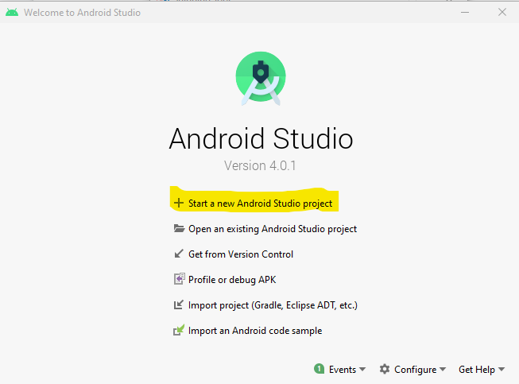
Mobile Computing
Start a New Android Studio Project

Slide 28
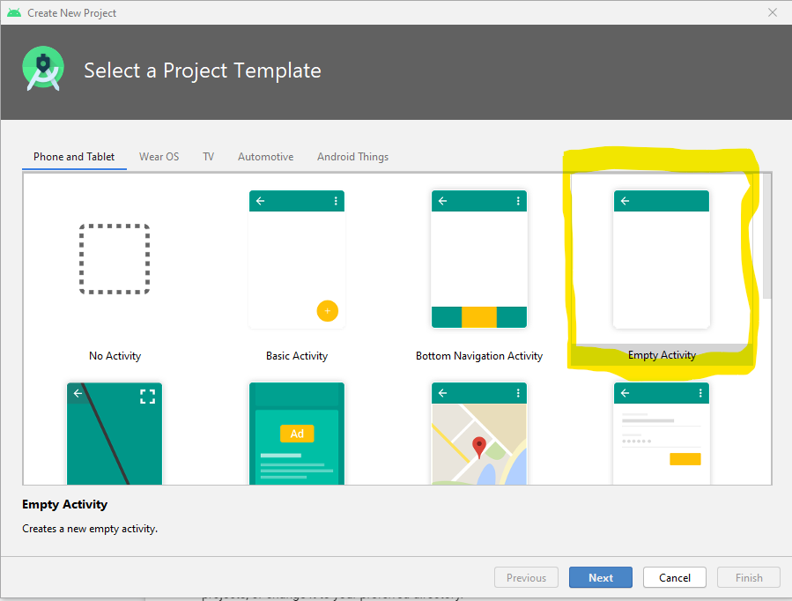
Mobile Computing
Project Template Selection

Slide 29
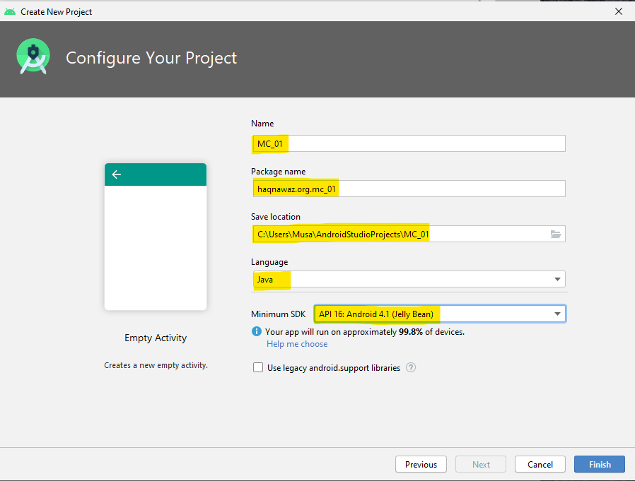
Mobile Computing
Project Configuration

Slide 30
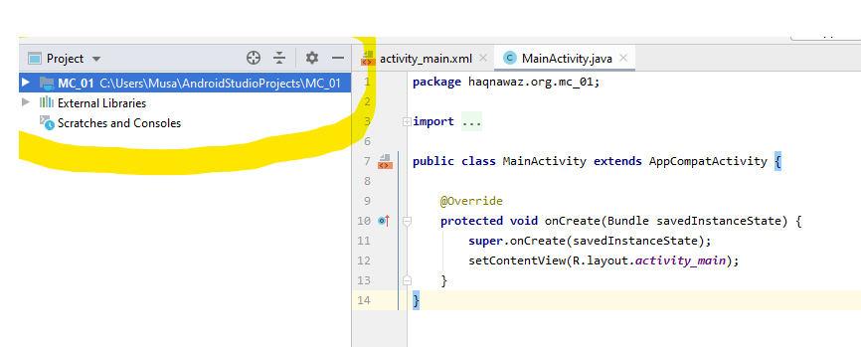
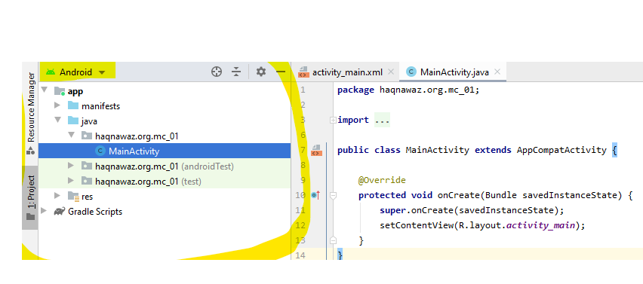
Mobile Computing
Default view / Android pane

Slide 31
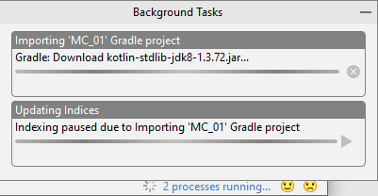
Mobile Computing
Project Configuration

Slide 32
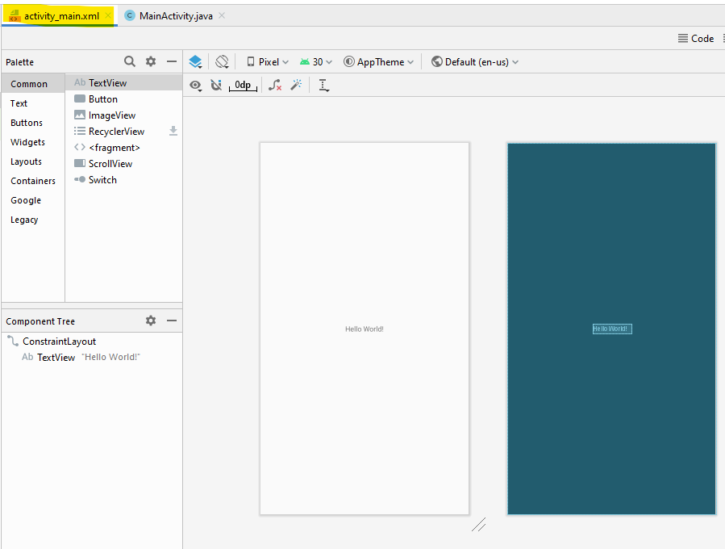
Mobile Computing
Configure Your Project

Slide 33
Mobile Computing
Gradle build system
Gradle build Android
Make it easy
To include External binaries or other library modules to your build as Dependencies
This folder contains all the files needed by the build system.

Slide 34
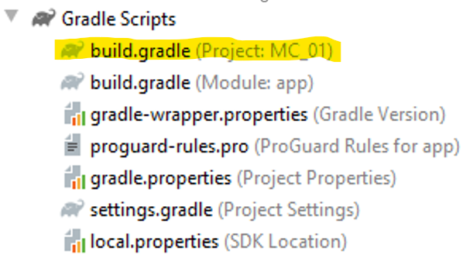
Mobile Computing
Gradle build system

Slide 35
Mobile Computing
Gradle build file
Every Android Studio project contains
1
Single
2
Top Level
3
Wont need to make any changes

Slide 36
Mobile Computing
build.gradle

Slide 37
Mobile Computing
Configure Your Project

Slide 38
Mobile Computing
Configure Your Project

Slide 39
Mobile Computing
Configure Your Project

Slide 40
Mobile Computing
Configure Your Project

Slide 41
Mobile Computing
Configure Your Project

Slide 42
Mobile Computing
Configure Your Project

Slide 43
Mobile Computing
Configure Your Project

Slide 44
Mobile Computing
Configure Your Project

Slide 45
Mobile Computing
Configure Your Project

Slide 46
Mobile Computing
Configure Your Project

Slide 47
Mobile Computing
Configure Your Project

Slide 48
Mobile Computing
Configure Your Project

Slide 49
Mobile Computing
Configure Your Project

Slide 50
Mobile Computing
Configure Your Project

Slide 51
Mobile Computing
Configure Your Project

Slide 52
Mobile Computing
Start new Android Studio Project

Slide 53
Mobile Computing
Course Goals
Fundamentals of Mobile Computing
Android Development
Home Works
Assignments
Final Project

Slide 54
Mobile Computing
Mobile Computing
Use of computer on the move
Compute a computational problem
Movement of work process from usual fixed position to a more dynamic position
Mobile Computing is when a work process is carried out somewhere where it was not previously possible
Transmission of Data, voice, video reception, transmission and processing anywhere and anytime.
Mobile Computing is an umbrella term used to describe technologies that enable people to access services anytime and anywhere

